Slide 1
Unit Planning: Deconstructing Learning Outcomes
Dr. David M. Nongrum
Selection Grade Lecturer
Directorate of Educational Research & Training
Education Department

Slide 2
Module Objectives
By the end of the day participants will be able to:
Identify nouns & verbs in the Learning Outcomes
Identify Essential Knowledge areas for learners
Identify Essential Skills for learners to develop
Formulate Learning Objectives to cover the Learning Outcomes
Draw up Summative Assessment plans for each Learning Objective
Sequence the Learning Objectives in logical order

Slide 3
Proposed Workshop Norms
Demonstrate trust
Be trustworthy & trusting of others
Demonstrate healthy conflict
Listen to one another
Share what is on your mind
Demonstrate a growth mindset
Engage in dialogue to develop new ideas
Ask questions to learn and clarify
Silence cell phones

Slide 4
Step 1: Identify the Know & Do areas

Slide 5
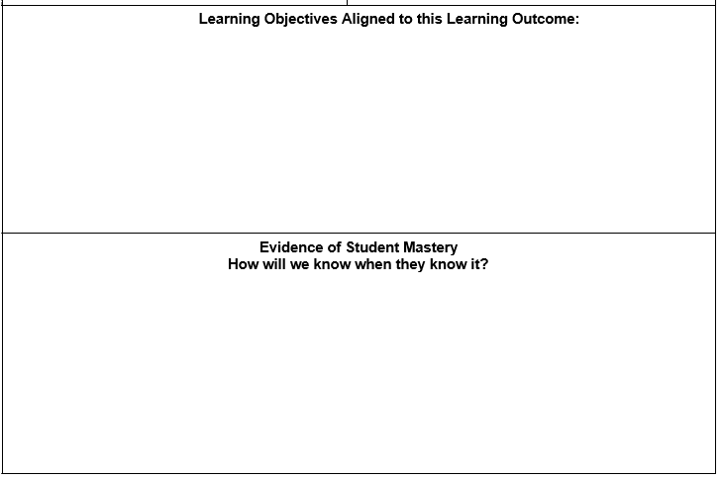
Stage 2: Develop Learning Objectives & Summative Assessment Plan

Slide 6
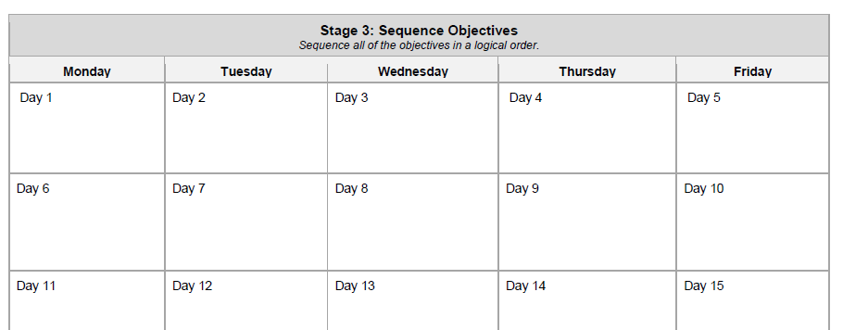
Stage 3: Sequence your objectives

Slide 7
Clear vision of Learning Outcomes
Research has found that some of the most common planning problems teachers experience actually arise from teaching without a clear vision of what they want students to learn (Bransford, Brown, & Cocking, 2001; Graff, 2011; Jones, Jones, & Vermette, 2011; Wiggins & McTighe, 2011).
When students see a purpose to what they are learning and know what they are trying to accomplish, they are more likely to have academic success (Wiggins & McTighe, 2005).

Slide 8
Backwards Unit Planning
Backwards planning a unit allows a teacher to ensure that all aspects of the learning experience are aligned. This alignment process can be done in three stages.
1. Set the vision: In this stage, teachers identify standards/outcomes that are to be learned in the unit, break down those standards into objectives, and create essential questions (Wiggins & McTighe, 2011, 2005).
2. Create a summative assessment: Creating an assessment before beginning the unit helps ensure that learning activities are rigorous and aligned to standards and objectives (Graff, 2011; Jones, Jones, & Vermette, 2011; Popham, 2011; Wiggins & McTighe, 2011, 2005).
3. Sequence objectives: Logically ordering objectives helps ensure that the unit is organized, cohesive, and “flows”. Sequencing the content of the unit in a logical way can help build students’ conceptual understandings.

Slide 9
Skill in Action for Participants
Teachers who use backwards design create units that are organized and lead to greater student mastery.
Both teachers and students have clarity around the goals of the unit, what is to be learned, and why it is important to learn it.
Lessons build upon each other sequentially and cover all of the important knowledge and skill that is reflected in the summative assessment.
The summative assessment is aligned to all of the standards identified for the unit and measures knowledge at the appropriate level of rigor.

Slide 10
Thanks for the patient listening

